Slide 1
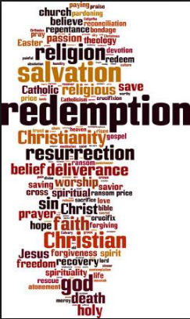


Slide 2


Slide 3
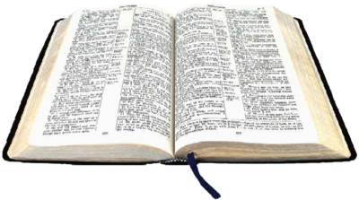
John 2:13-21

Slide 4
Matthew 16:21
“From that time Jesus began to show His disciples that He must go to Jerusalem, and suffer many things from the elders and chief priests and scribes, and be killed, and be raised up on the third day.”

Slide 5
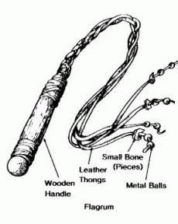

Slide 6
John 12:27
"Now My soul has become troubled; and what shall I say, 'Father, save Me from this hour'? But for this purpose I came to this hour.”

Slide 7
Matthew 26:36-46

Slide 8
Galatians 3:13
“Christ redeemed us from the curse of the Law, having become a curse for us-for it is written, ‘CURSED IS EVERYONE WHO HANGS ON A TREE’”

Slide 9
Mark 15:29-40

Slide 10
Hebrews 12:3
“For consider Him who has endured such hostility by sinners against Himself, so that you will not grow weary and lose heart.”

Slide 11
Luke 23

Slide 12
Psalm 22

Slide 13
Matthew 28:2-3
“And behold, a severe earthquake had occurred, for an angel of the Lord descended from heaven and came and rolled away the stone and sat upon it. And his appearance was like lightning, and his clothing as white as snow.”

Slide 14
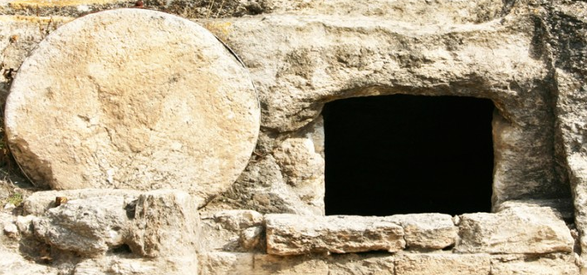
Christ Arose!

